Slide 1
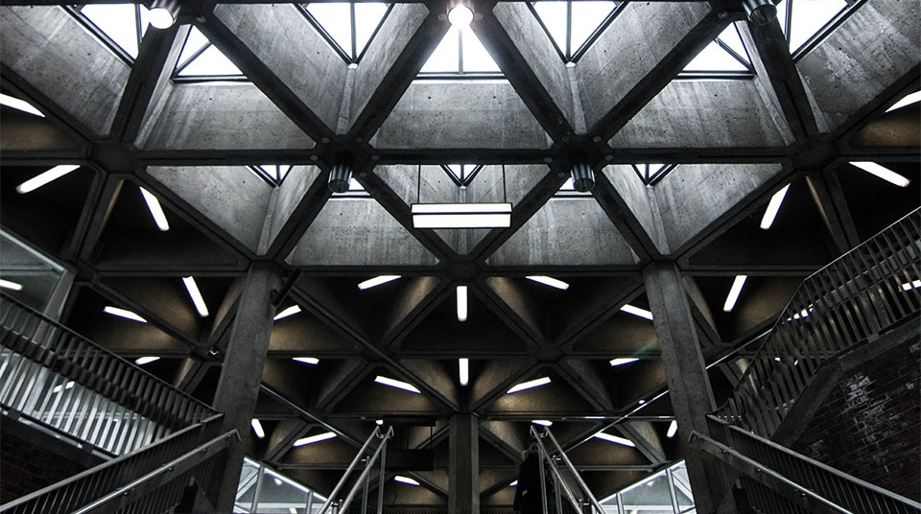

MEMENTO PUZZLER
2
+
2
+
PRESENTED BY: UTSAV SHARMA
218528291

Slide 2


PHASE I- Introduction project goals development PROCESS
2
+
2
+

Slide 3
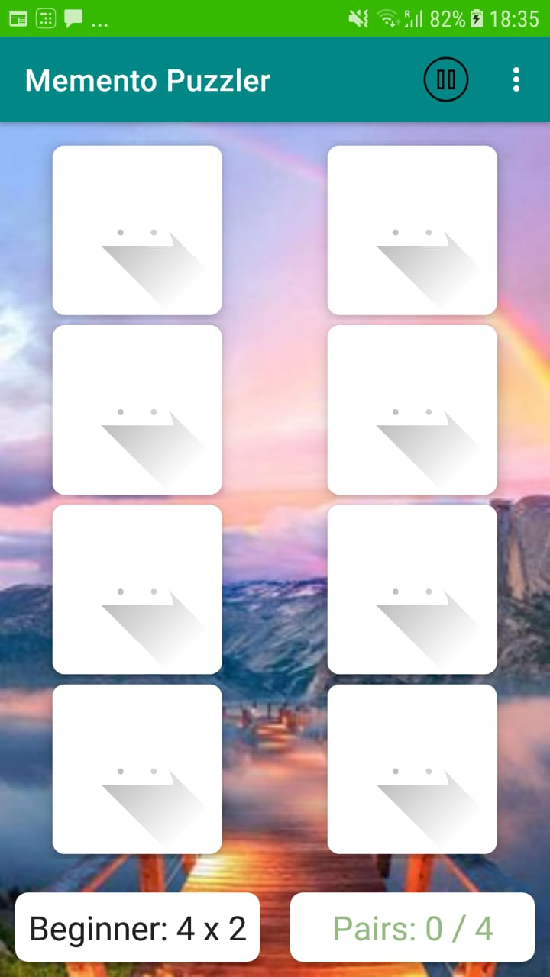
iNTRODUCTION
2
+
The Memento Puzzler is an Android Gaming Application.
It is intended to be played by kids as well as teenagers and adults.
Designed on Android Studio.

Slide 4
PROJECT GOALS
Application’s aim is to enhance a child’s memory and help adults to concentrate.
A fast-paced game with three different levels.
Contains a simple User interface which isn’t clustered with various buttons, which can be found in existing applications.
Serves its sole purpose of enhancing the player’s memory and concentration skills.

Slide 5
development PROCESS
Initially designed a High-Fidelity prototype on Figma, which serves as a blueprint for my final project.
Learnt how to code in Kotlin and work on Android Studio.
Completed the weekly tasks conducted in the practical's and upskilled myself.
Went through many tutorials to learn about different coding concepts.

Slide 6
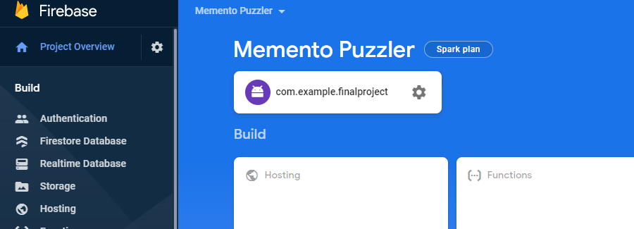
development PROCESS
Made many changes in my final design as I removed various functions of the application.
For my application’s storage, I used Firebase Cloud Storage.
Learnt about Firebase through Deakin Sync and tutorials.
It helped in creating a custom game for my application.

Slide 7
PHASE II- KEY FEATURES
2
+
2
+

Slide 8
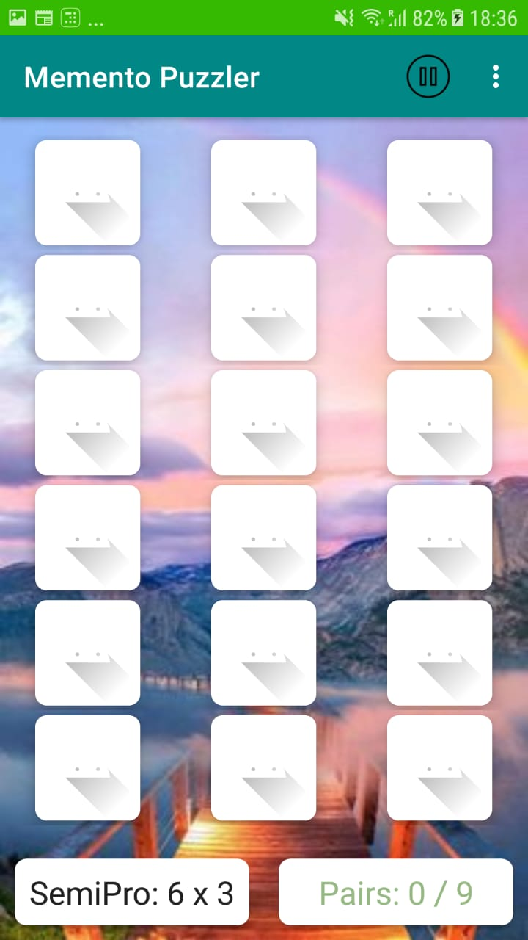
Gaming page
This image is of the SEMI PRO Level.
The player’s moves and number of pairs matched are counted.
Each card is revealed on tapping.
Each matching pairs are left open.

Slide 9
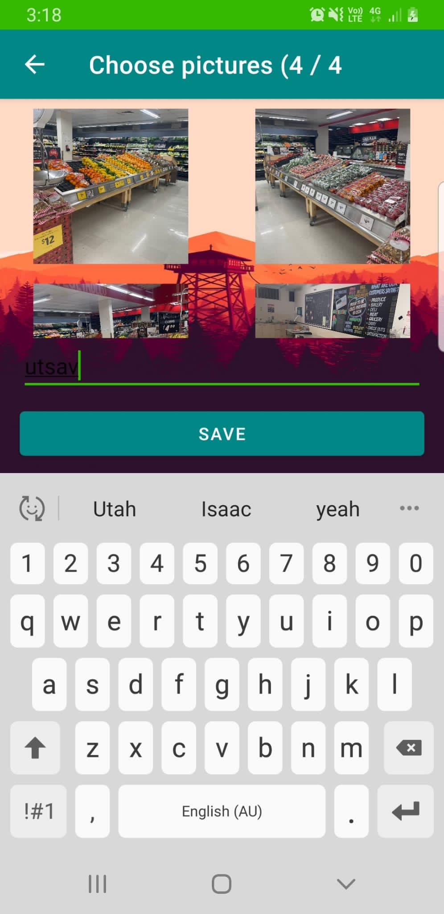
Custom game creation
Created with the help of Firebase Cloud Storage.
Went through many tutorials to get this working.
A player can choose random images form their mobile’s gallery and create their own custom game.

Slide 10
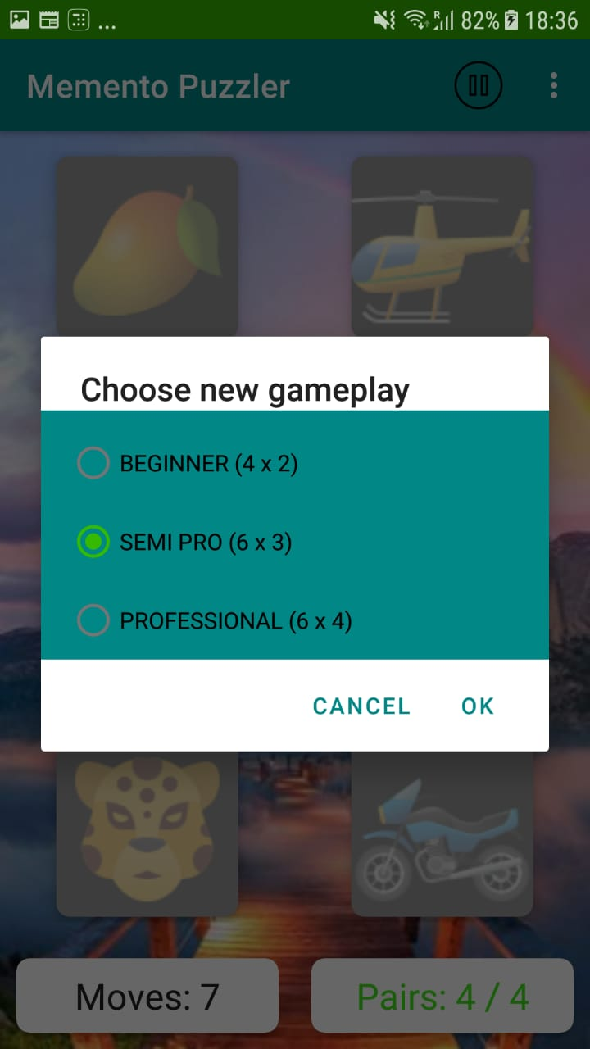
gamecentre
The game has three different gaming levels.
This feature can be found from the menu section of the game.
Radio Buttons are used in its design.

Slide 11
PHASE iII- CHALLENGES
2
+
2
+

Slide 12
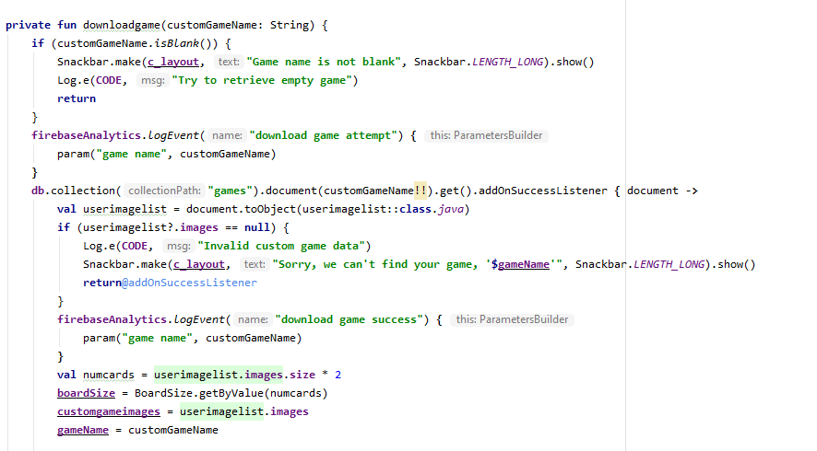
coding
I went through a few tutorials before I began with my coding.
Creating different files and connecting each page.
Defining logic for each function.
Setting up the game’s board and defining different dimensions for each level.

Slide 13
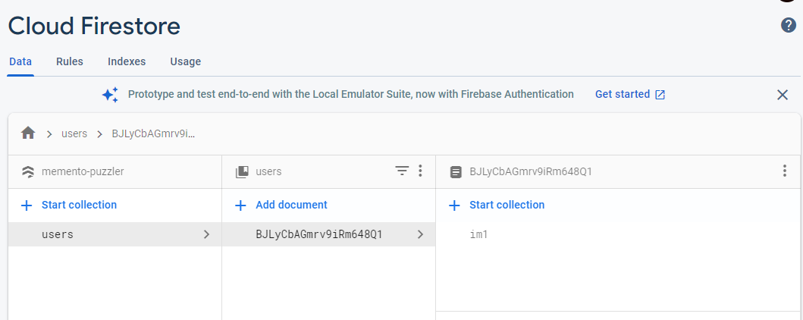
FIREBASE
Learning about its different features.
Use of its libraries such as storage, analytics, remoteConfig.
Creating different files and connecting each page.

Slide 14
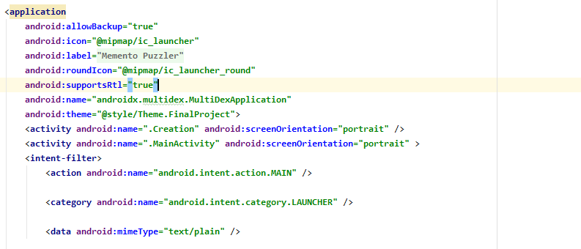
GRADLE AND MANIFEST FILES
Using Multidex.
Defining different implementations for firebase libraries.

Slide 15
PHASE Iv- project demonstration
2
+
2
+

Slide 16
THANK YOU
2
+
2
+

